Slide 1
Secure Vault
Under The guidance of Prof.Thomas Abraham J

Slide 2
What is Secure Vault ?
Personal Vault is a software which could be used to store textual data that is confidential.
It uses a combination of file encryption and username/password authentication to prevent unauthorized access.

Slide 3
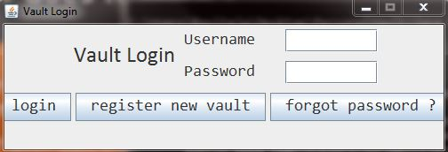
How does it Work ? (VaultLogin)
The user is first shown a login screen which prompts the user for a username/password combination.
The user can enter his username/password combination to login into his/her account.
The user can also register for a vault if he/she doesn’t have a vault via the register vault button.
If the user has a account but forgot his / her password then they can press on the forgot password button to reset their password, provided the anser to the secret question is correct.

Slide 4
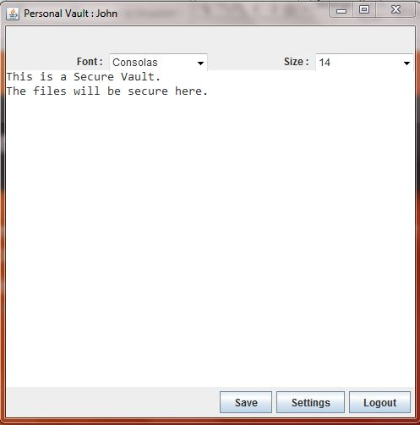
The Vault (PersonalVaultGUI)
After successfully logging into their accounts, users can enter the data that is to be saved.
The users can also change the font and font sizes as they prefer.
After clicking on the save button, the data will be encrypted and saved to a file, and the preferences will also be saved to the user’s database.

Slide 5
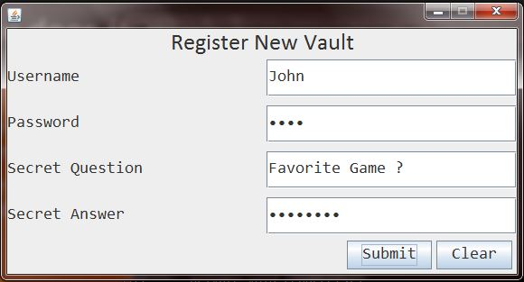
Vault Registration (RegisterGUI)
The RegisterGUI is used to register an account for the user.
It implicitly uses the JDBC connection to insert vales to the database.

Slide 6
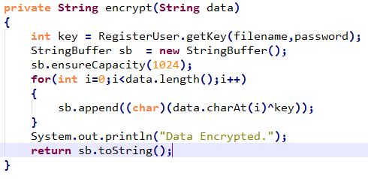
Encryption Method Used
The Encryption method that is used is XOR encryption.
At the time of registering for a vault, the system generates a Random key for each user and stores it in the database, which can be later used for Encryption / Decryption purposes.

Slide 7
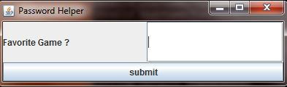
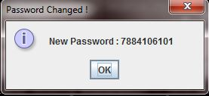
Resetting Password (PasswordHelper)
The user can reset his password by entering the answer to the secret question which he enters during the time of registering for a vault.
After entering the answer to the secret question, the system generates a random password which can be used to login to the vault.

Slide 8
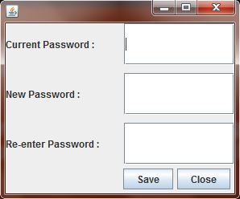
Changing Password (SettingsGUI)
To change the password the user can simply login to his account and press the settings button to change his password.
A dialog appears asking for the current password and new password, after entering the passwords , the password will be changed immediately.

Slide 9
Project Modules
Module Name | Module Description | Done By,
VaultLogin | The Login GUI and JDBC Connections for retrieving the credentials | Kishore Ram J S
PersonalVaultGUI | The Vault GUI, Changing Fonts | Theja B.S.R
RegisterUser | Vault Registration GUI , JDBC Connections | Gnana Prakash
PasswordHelper,SettingsGUI | Changing password of user, JDBC Connections | Manigandan V
LoginCheck,Encryption,File Handling | Encrypt Files , Validating Username/Password. | Vishwanth J

